Slide 1


Automated Alpha Attribute Selection
Rank Trace Attributes
Instantiating new Alpha Attributes
Scoping Analysis
Data pre-Processing
Raw Data
XES Event Log
In Depth Comparison
Stochastic insights into sub-log differences
Identifying Comparable Sub-logs
Stochastic Clustering
Pair Comparison
Results
Interpretation and Validation

Slide 2
Automated Alpha Attribute Selection
Rank Trace Attributes
Instantiating new Alpha Attributes
Data pre-Processing
Scoping Analysis
Raw Data
XES Event Log
In Depth Comparison
Stochastic insights into sub-log differences
Identifying Comparable Sub-logs
Stochastic Clustering
Pair Comparison
Results
Interpretation and Validation

Slide 3
Automated Alpha Attribute Selection
Rank Trace Attributes
Instantiating new Alpha Attributes
Data pre-Processing
Scoping Analysis
Raw Data
XES Event Log
In Depth Comparison
Stochastic insights into sub-log differences
Identifying Comparable Sub-logs
Stochastic Clustering
Pair Comparison
Results
Interpretation and Validation

Slide 4
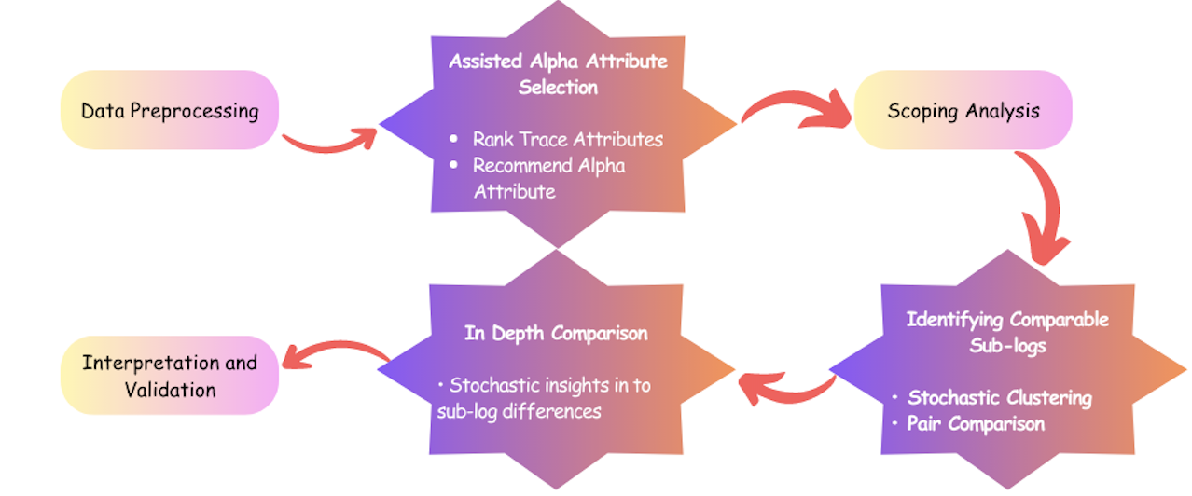
Notes:
https://www.canva.com/design/DAFklvFG6yw/VYbjuxOaahyswX46uV6vNQ/edit?utm_content=DAFklvFG6yw&utm_campaign=designshare&utm_medium=link2&utm_source=sharebutton

